Slide 1
Group Meeting 08/18/2020

Slide 2
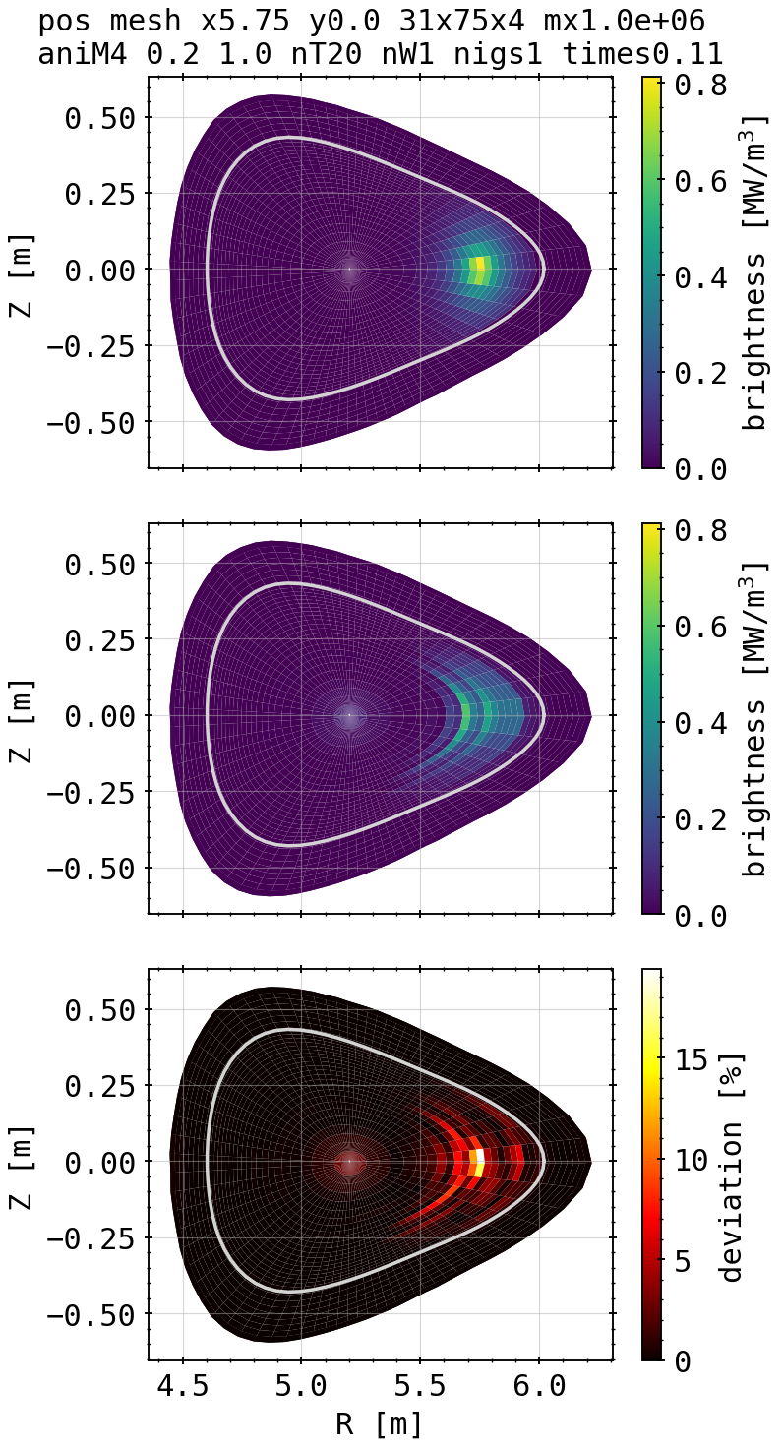
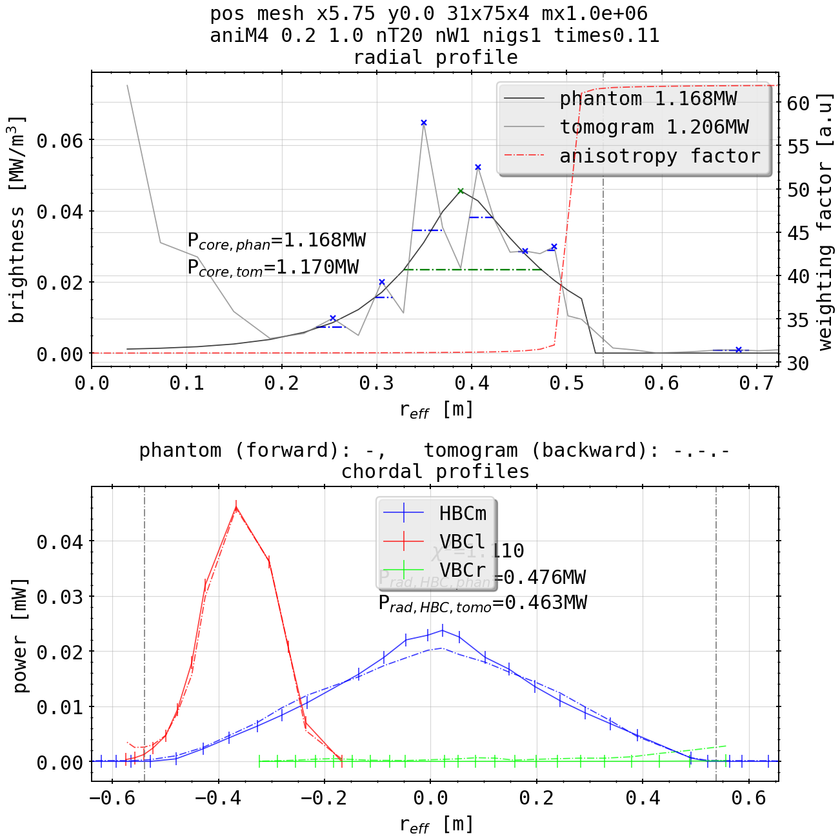
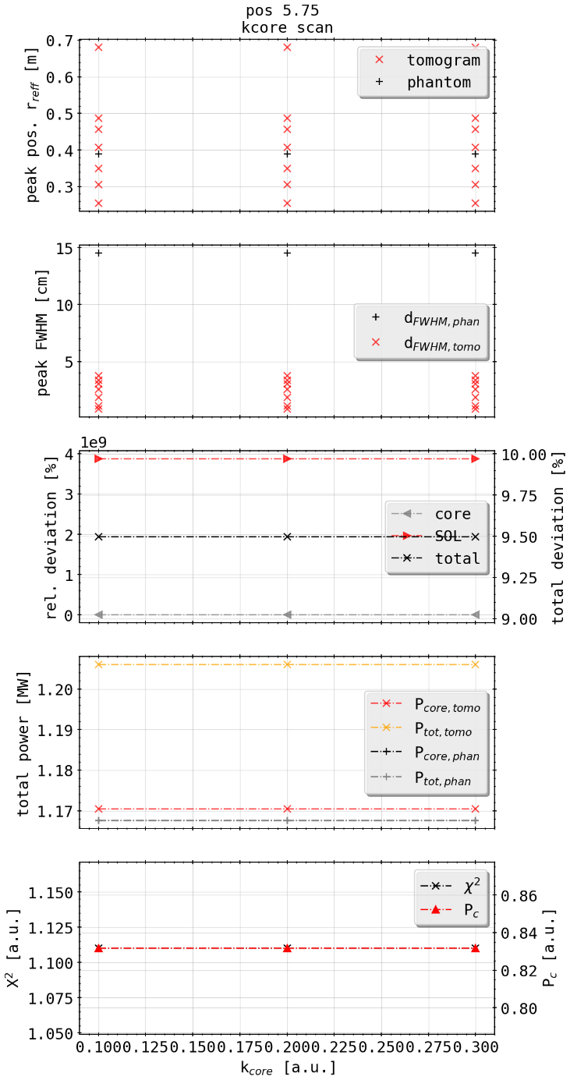
Phantom Test: Single Spot Off-Center
(phantom)
[cm]
[mm]
K scan at edge
(tomogram)

Slide 3
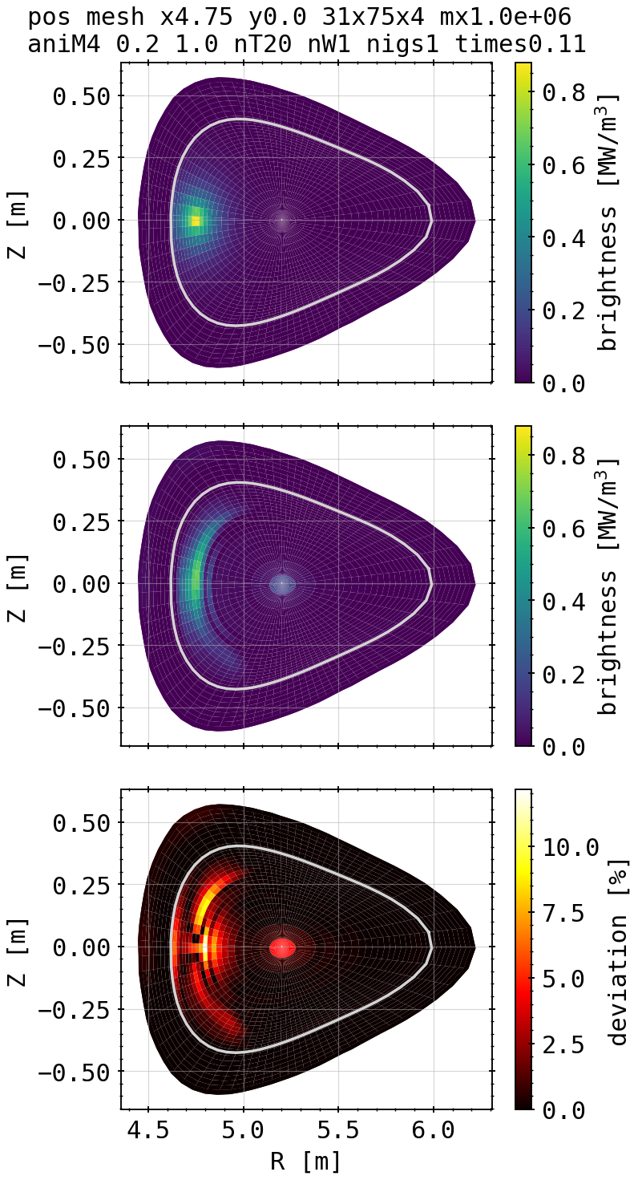
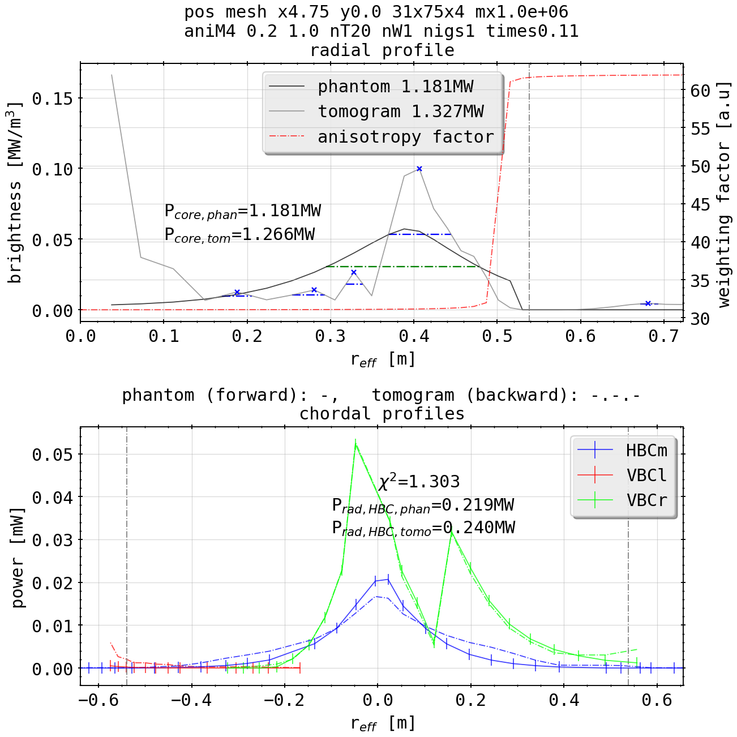
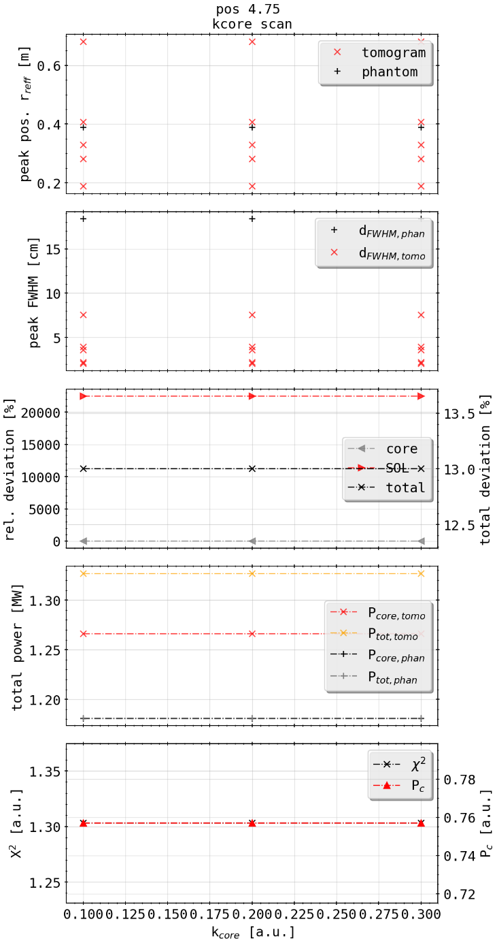
Phantom Test: Single Spot Off-Center
(phantom)
[cm]
[mm]
K scan at edge
(tomogram)

Slide 4
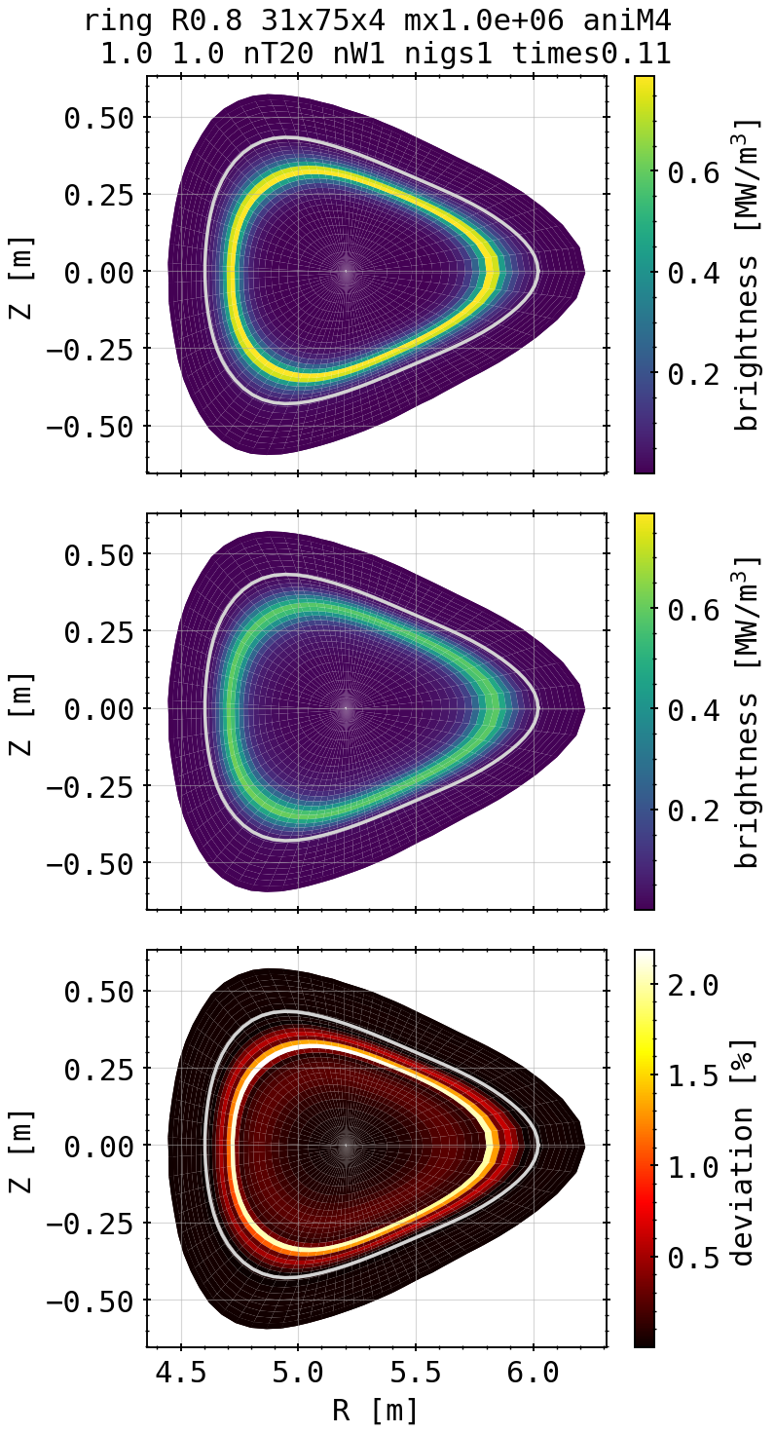
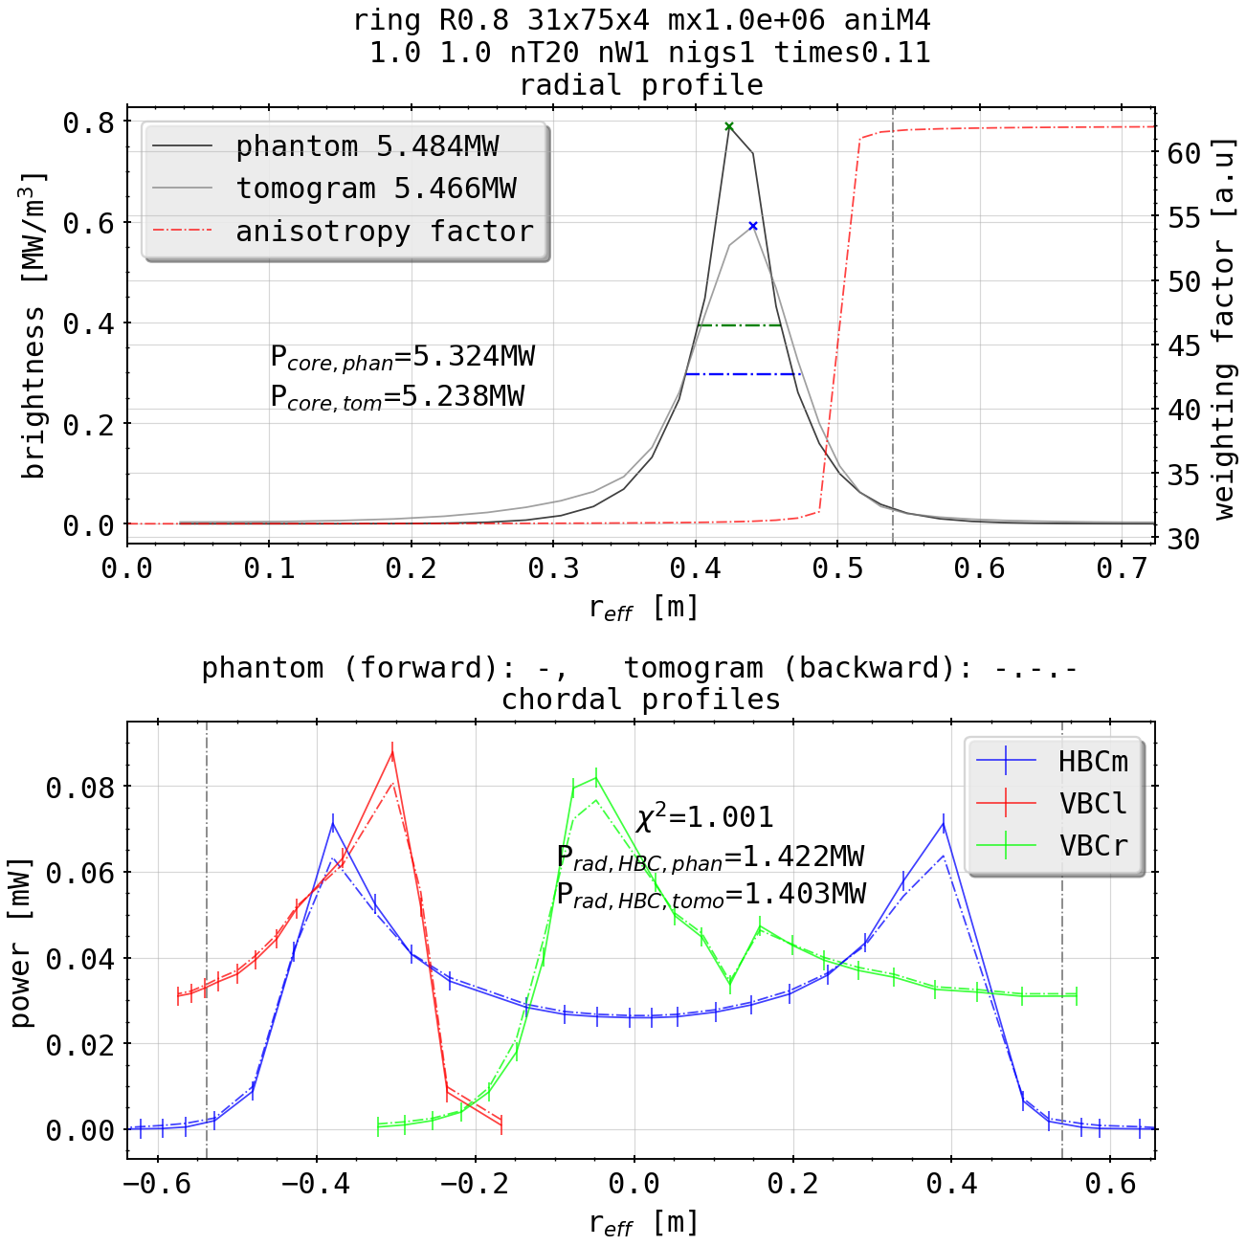
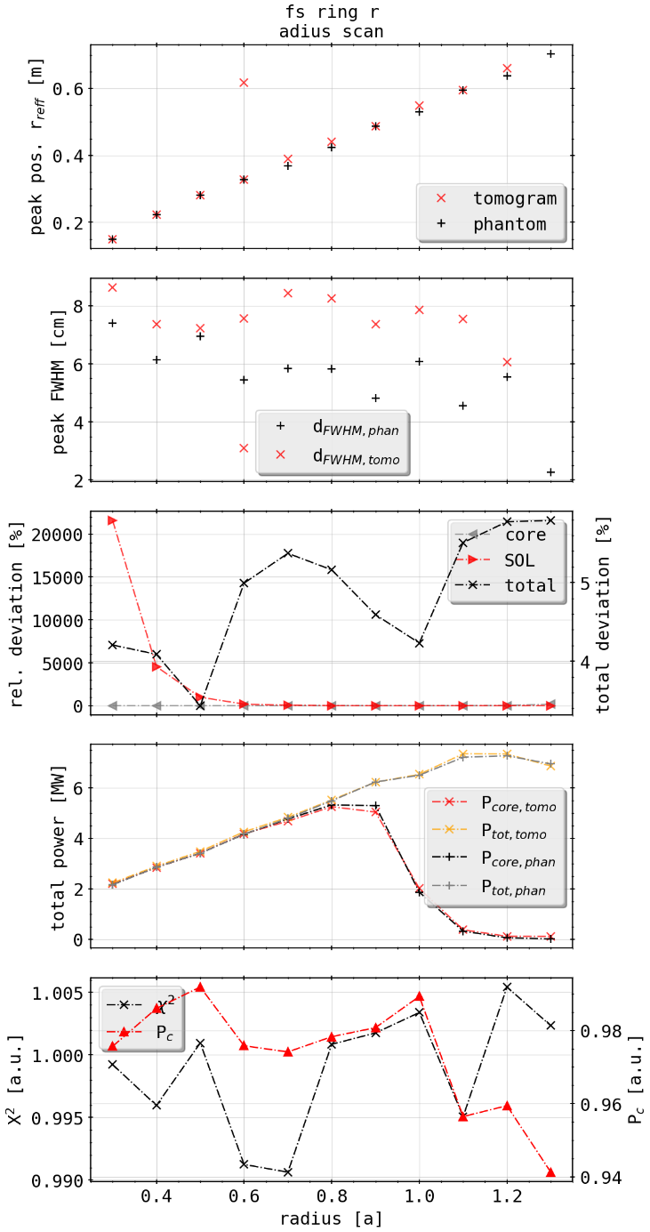
Phantom Test: Bright Ring
(phantom)
Radius scan
(tomogram)

Slide 5
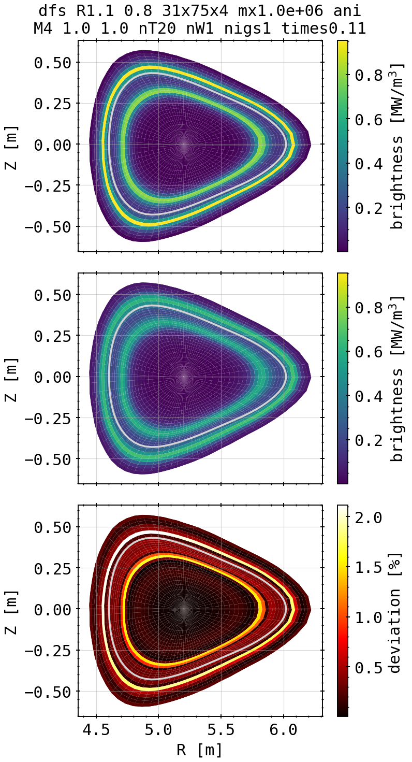
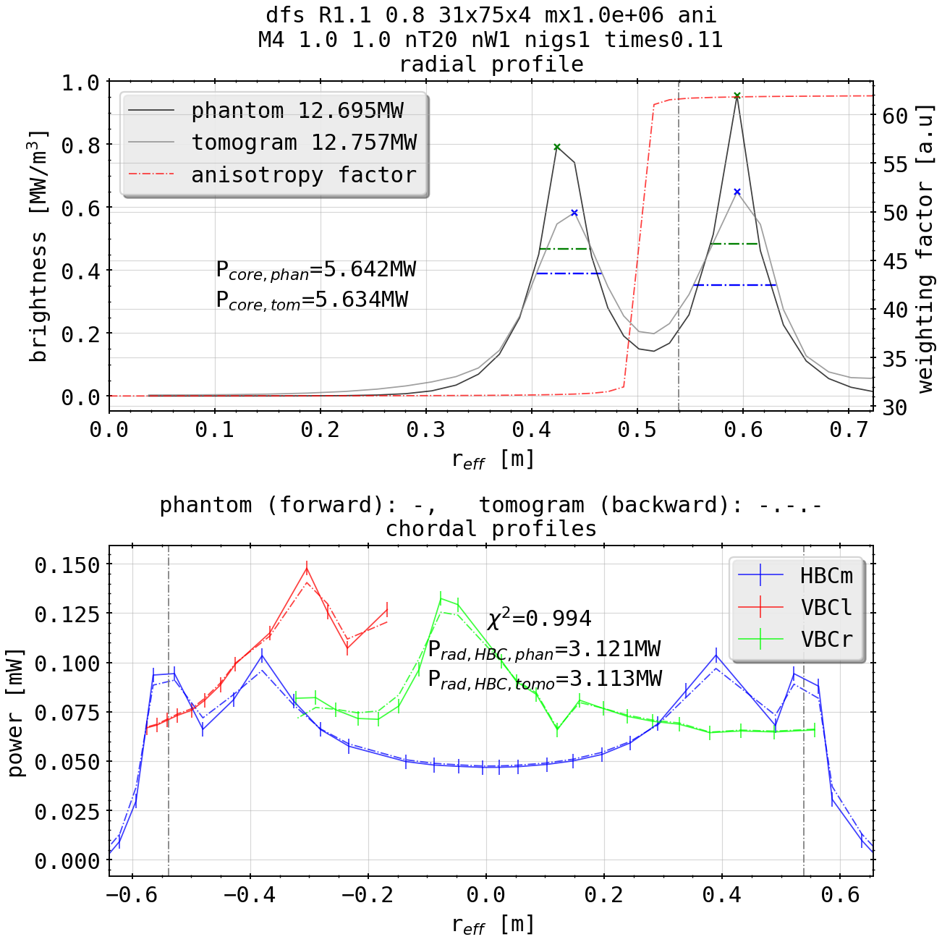
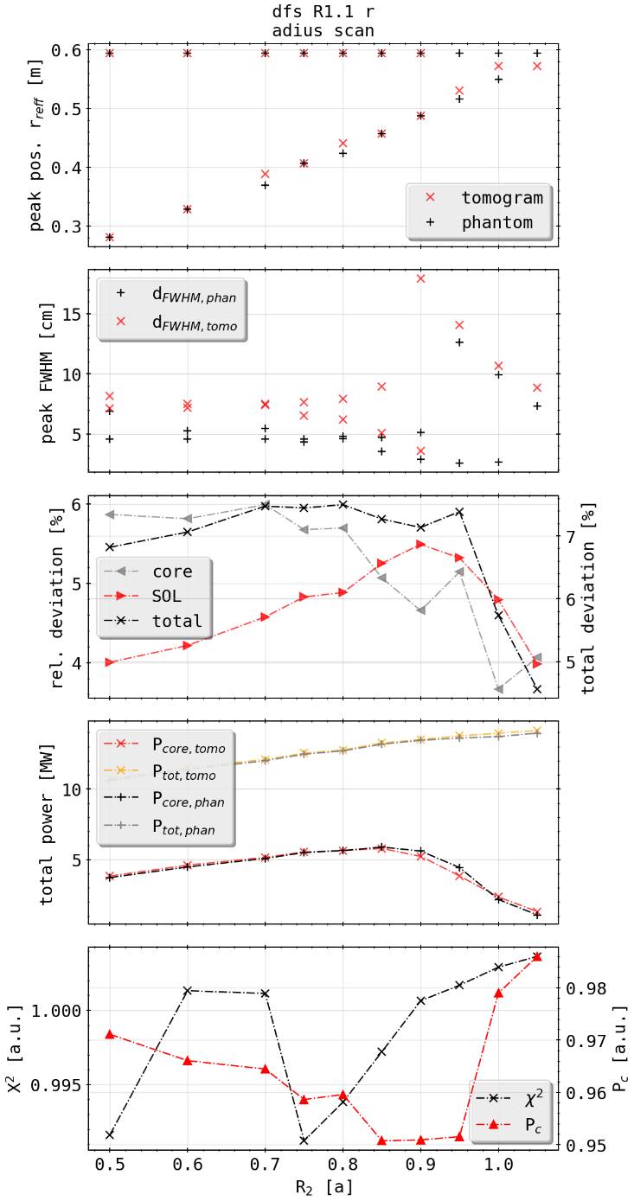
Phantom Test: Double Bright Ring
(phantom)
Radius scan
(tomogram)

Slide 6
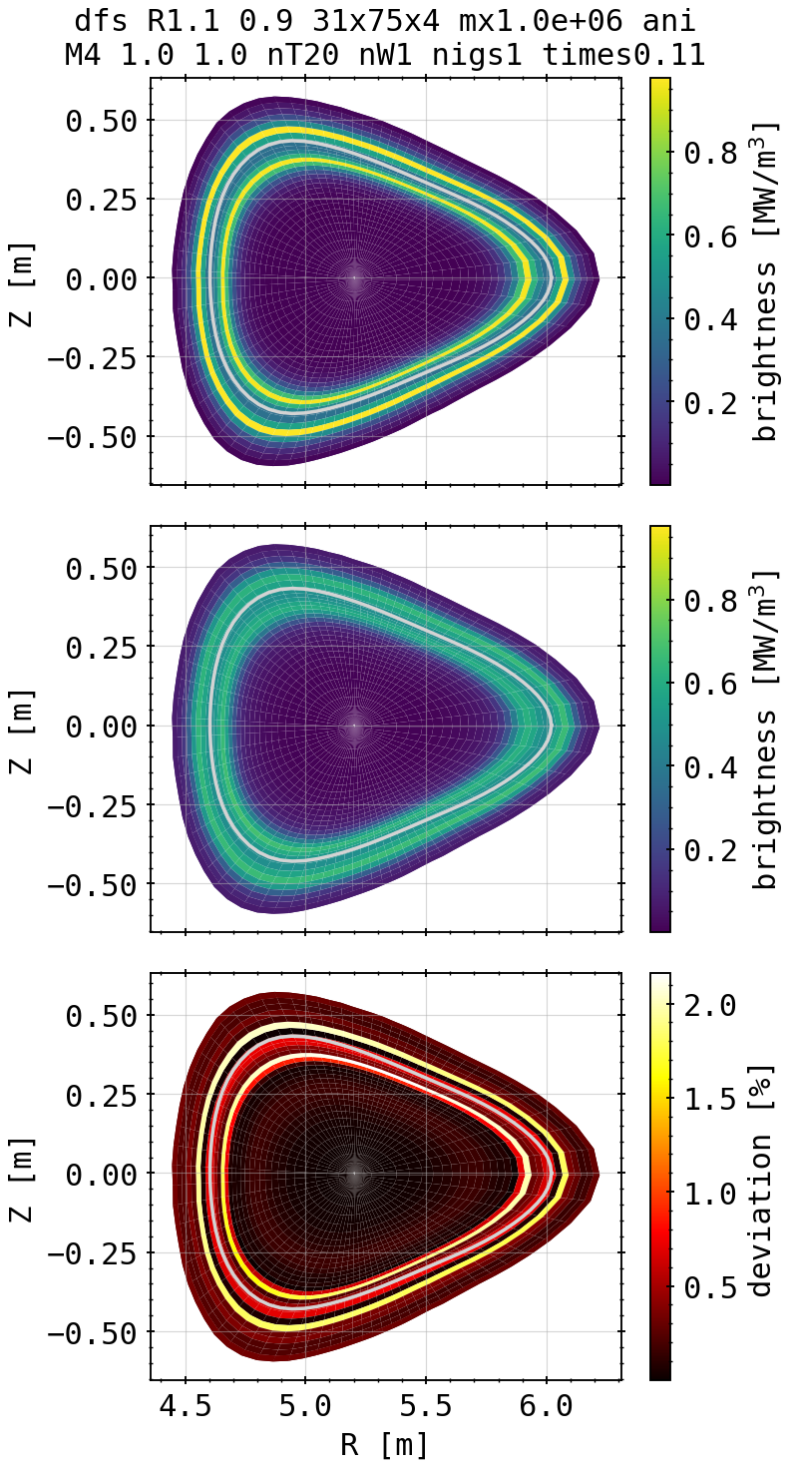
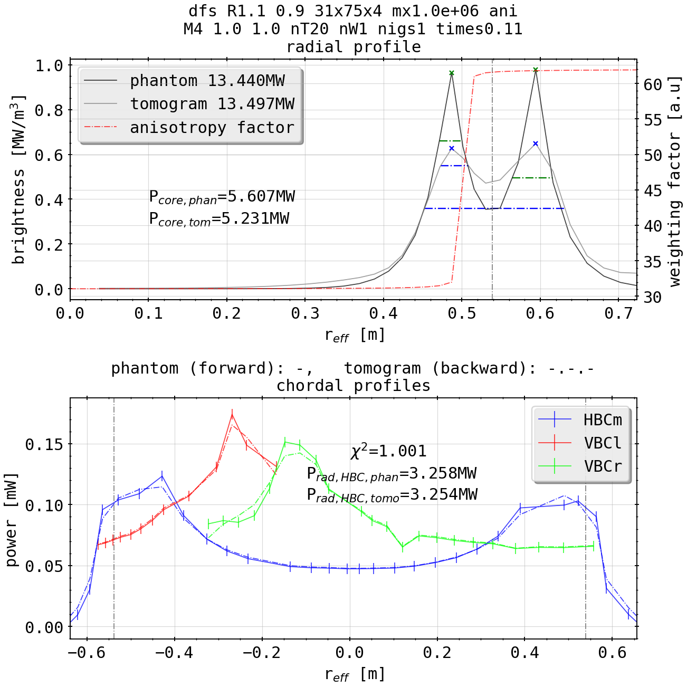
Phantom Test: Double Bright Ring
(phantom)
Radius scan
(tomogram)

Slide 7
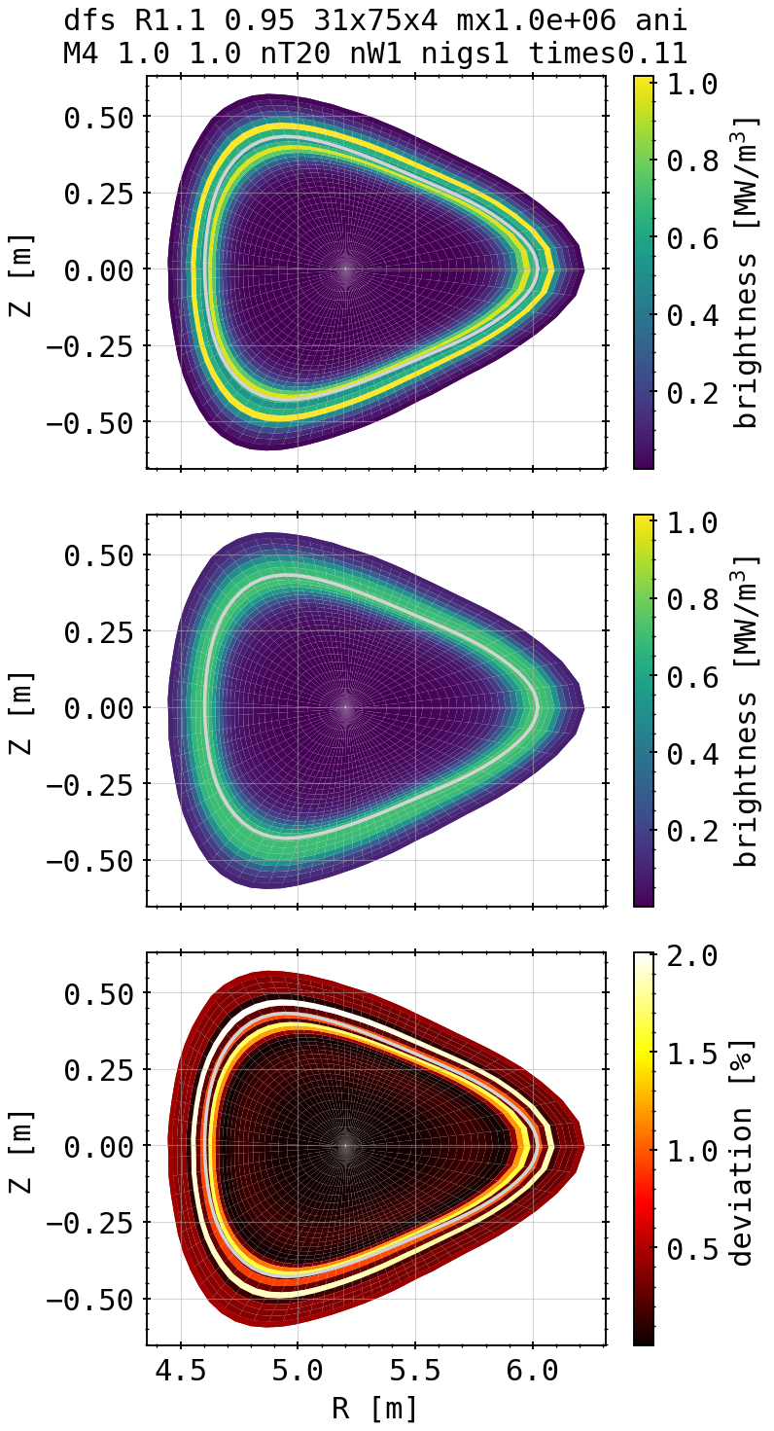
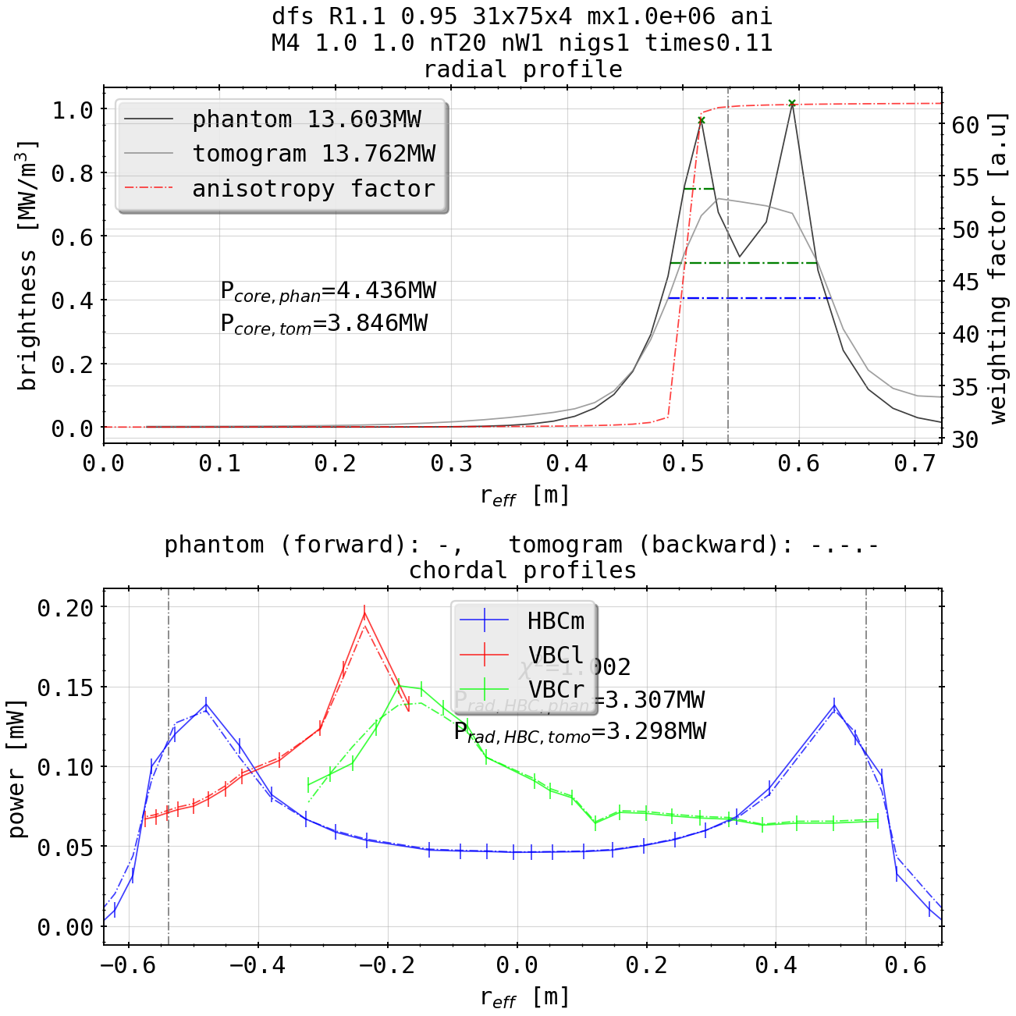
Phantom Test: Double Bright Ring
(phantom)
Radius scan
(tomogram)

Slide 8
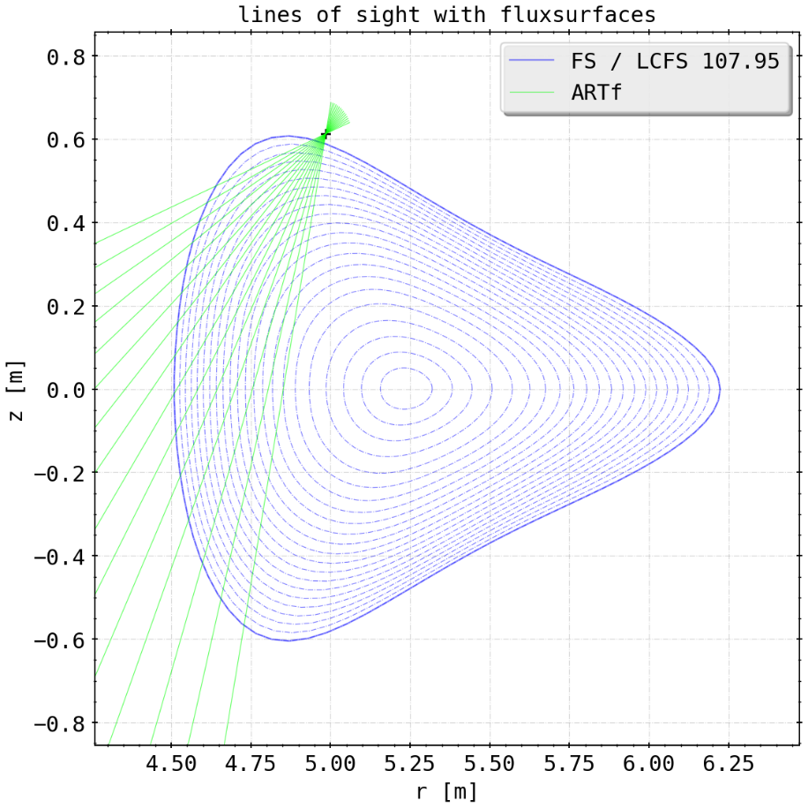
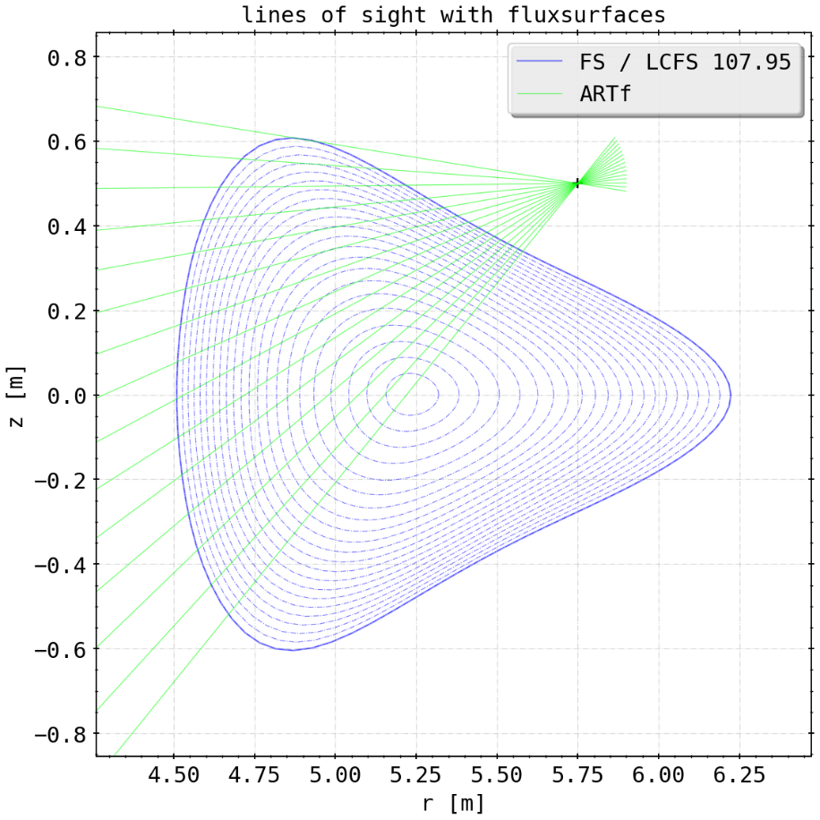
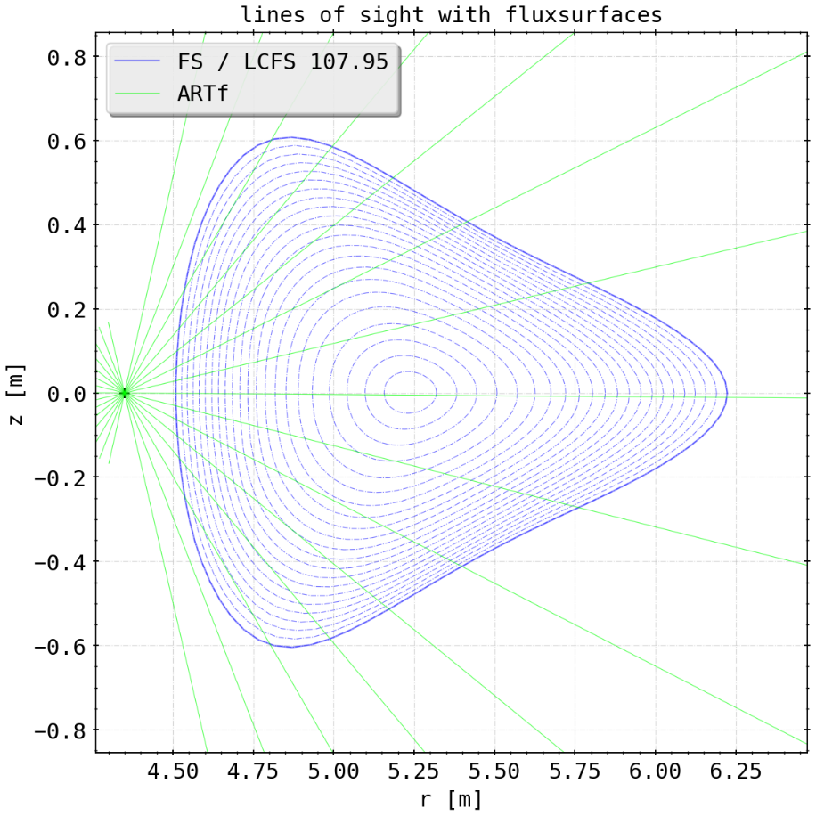
Phantom Test: New Cameras
adding new cameras at possible (1, 2) or impossible (3) positions, 15 channels each
ARTv (1)
ARTm (3)
ARTh (2)

Slide 9
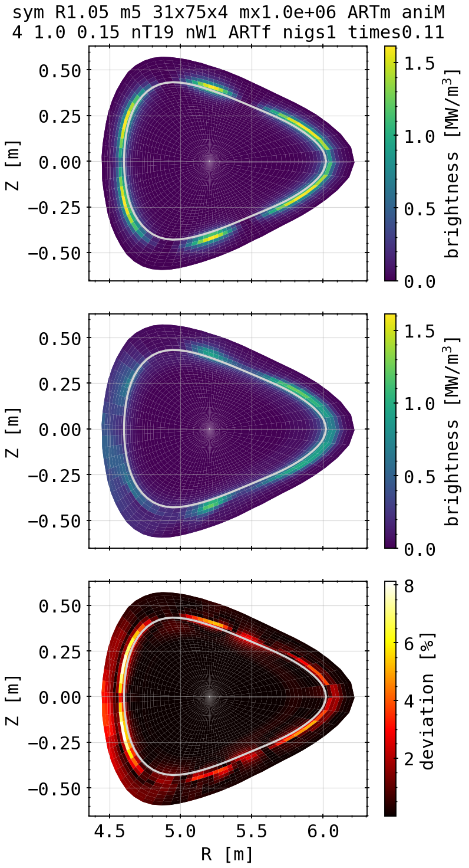
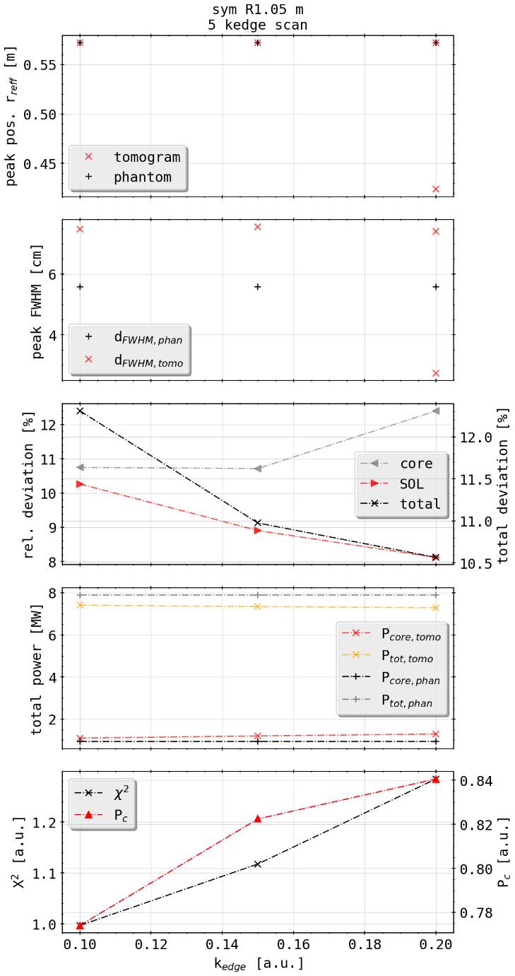
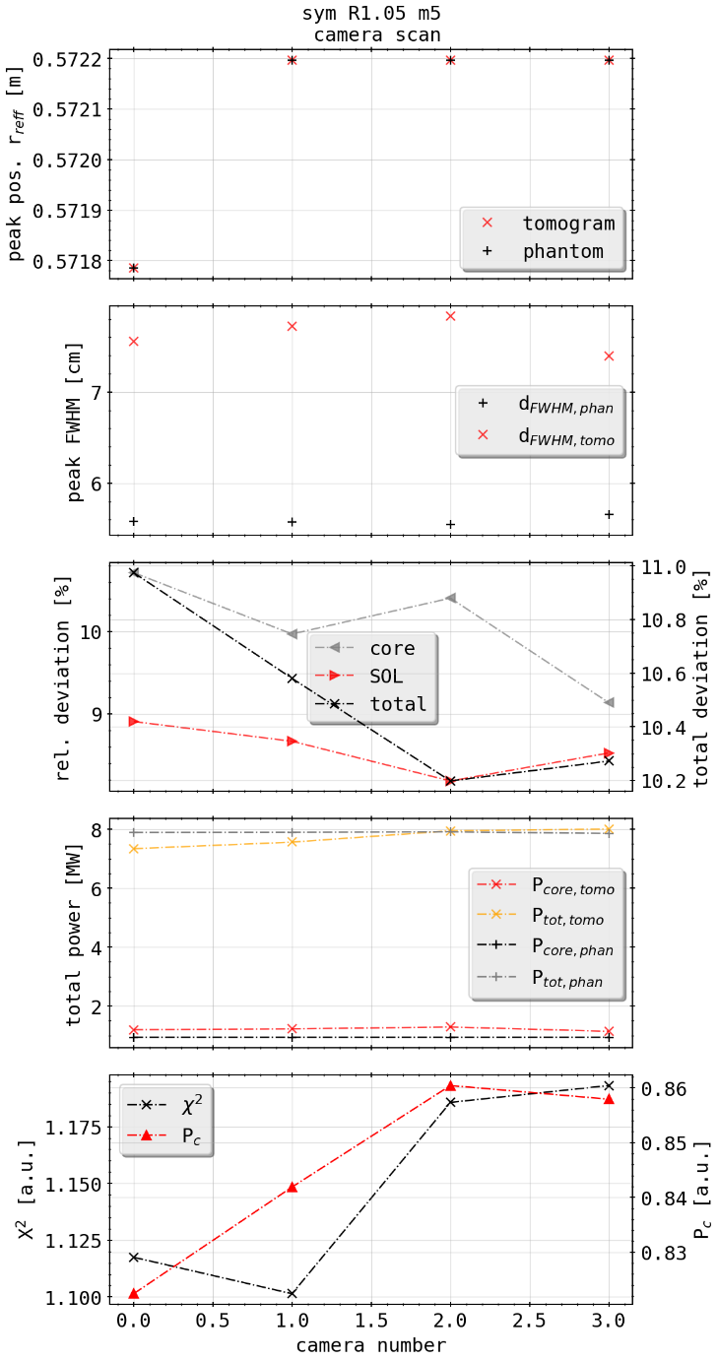
Phantom Test: Island Mimic and Artificial Cameras
K edge scan
Camera scan
ARTm (3)

Slide 10
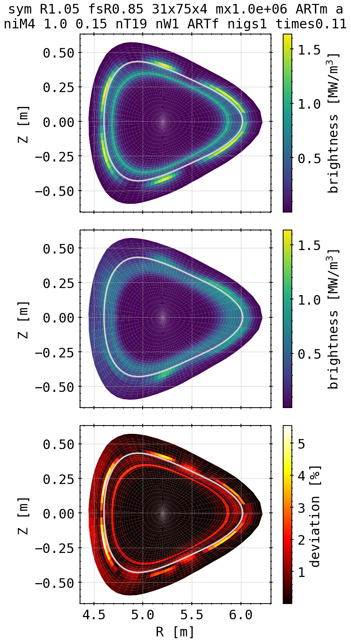
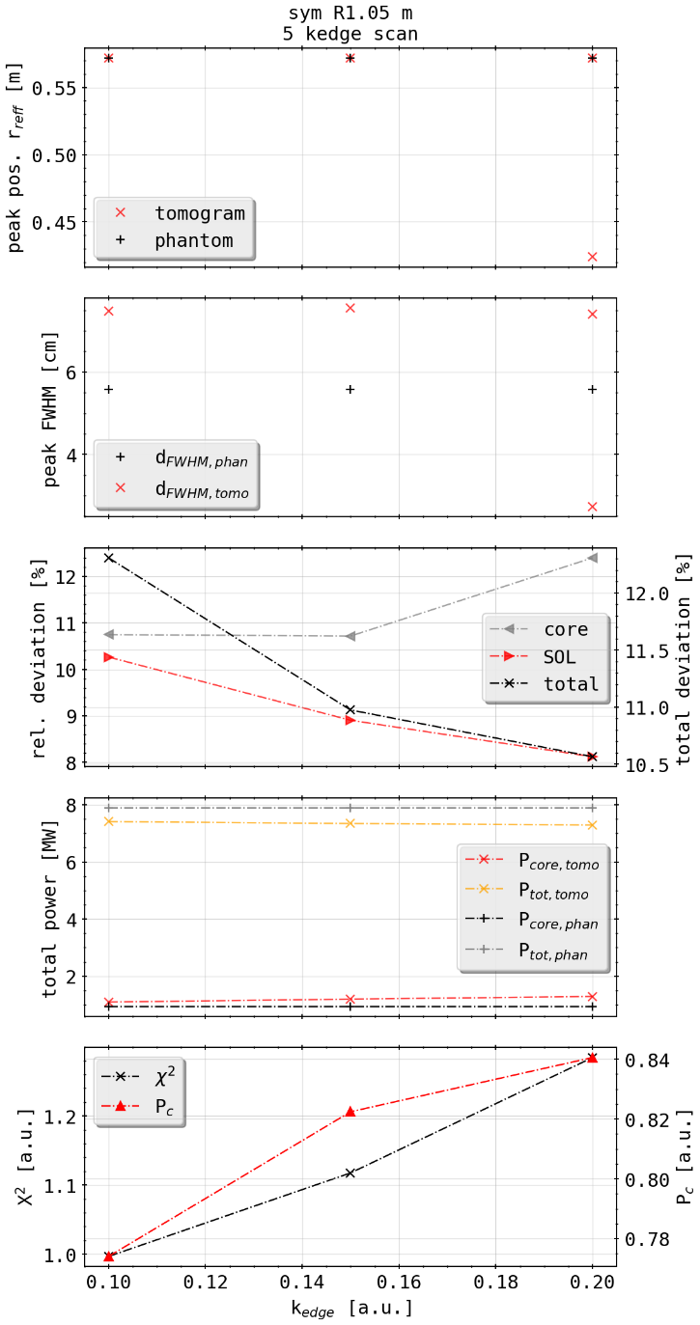
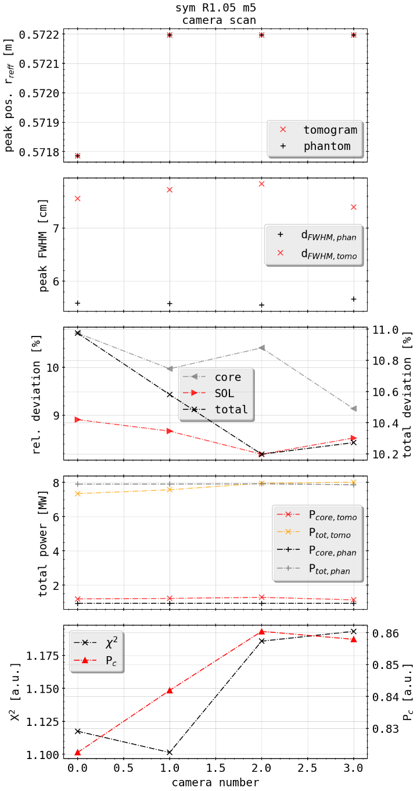
Phantom Test: Island Mimic with Ring and Artificial Cameras
K edge scan
Camera scan
ARTm (3)

Slide 11
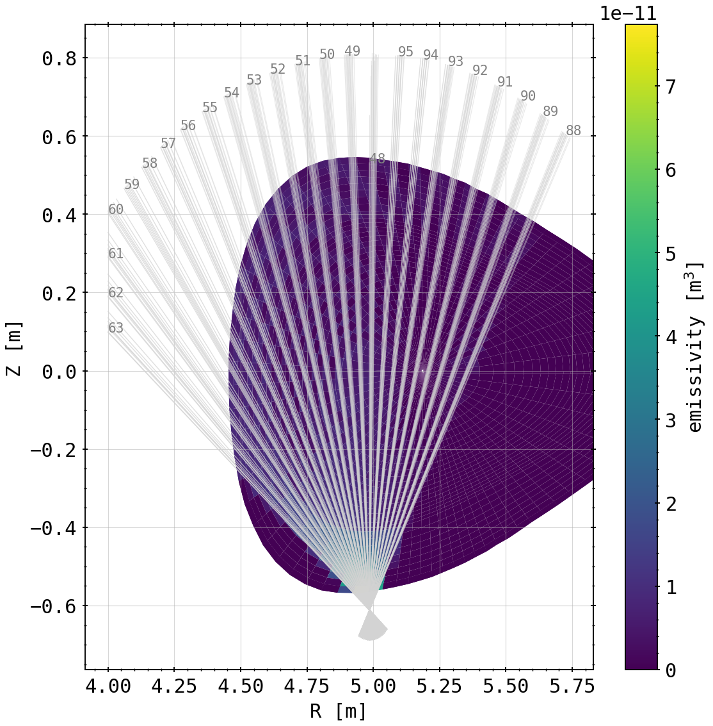
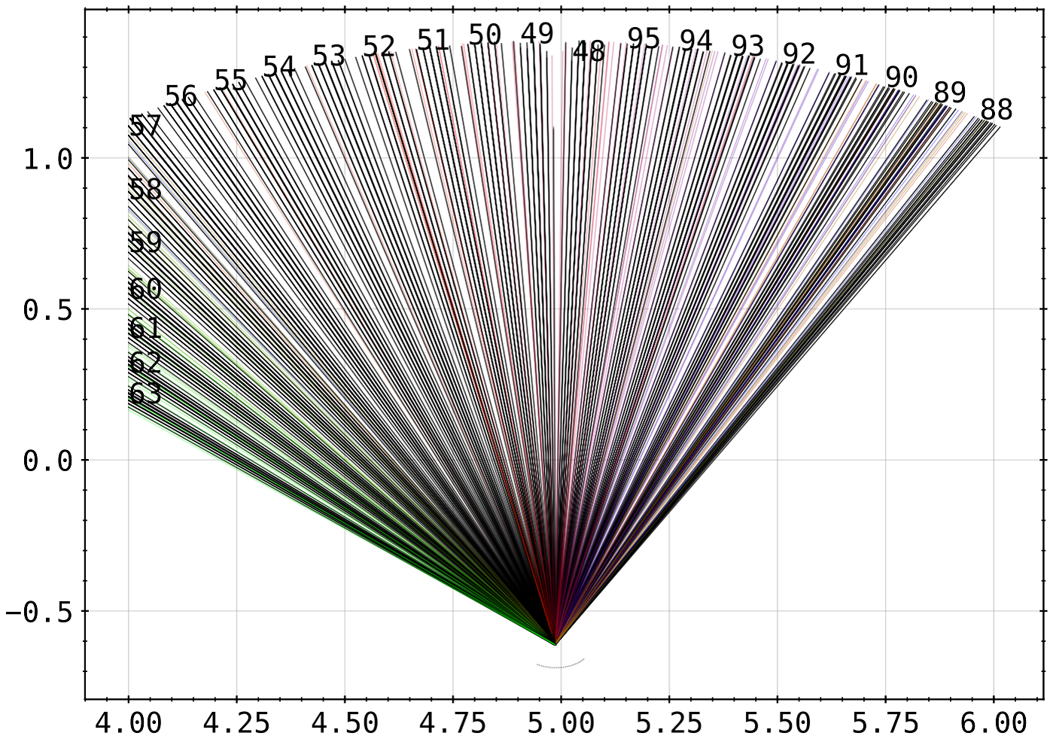
Issues: Line of Sight Geometry
(correct projection)

Slide 13
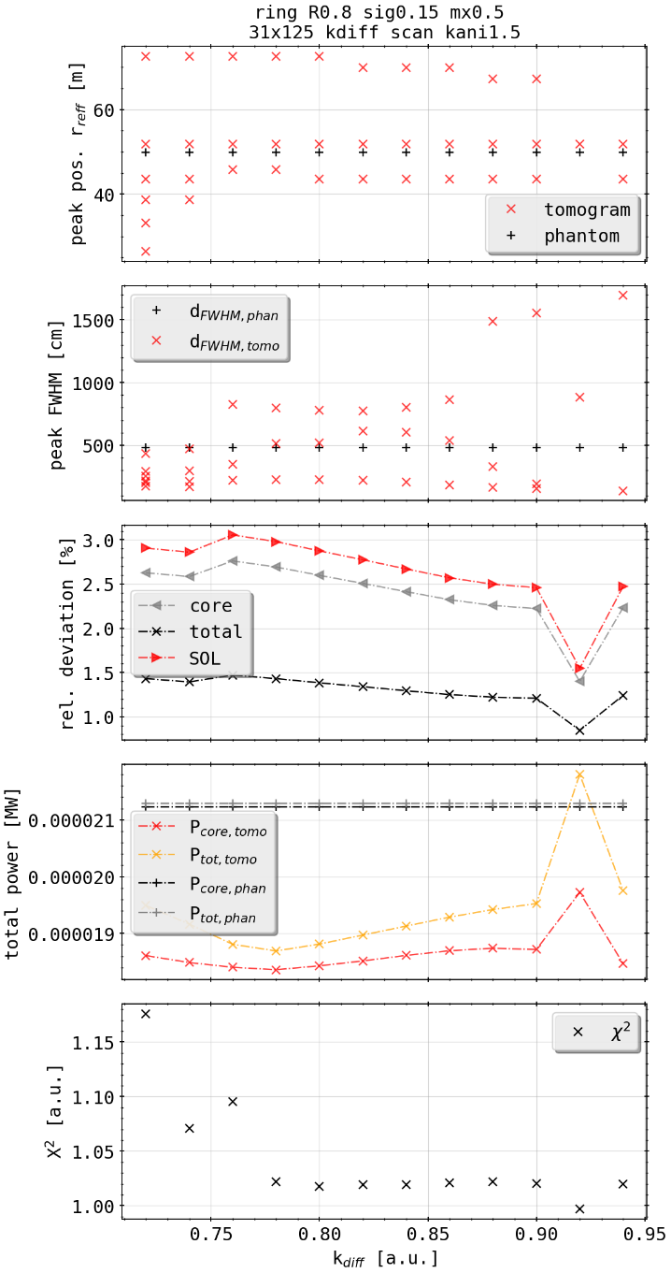
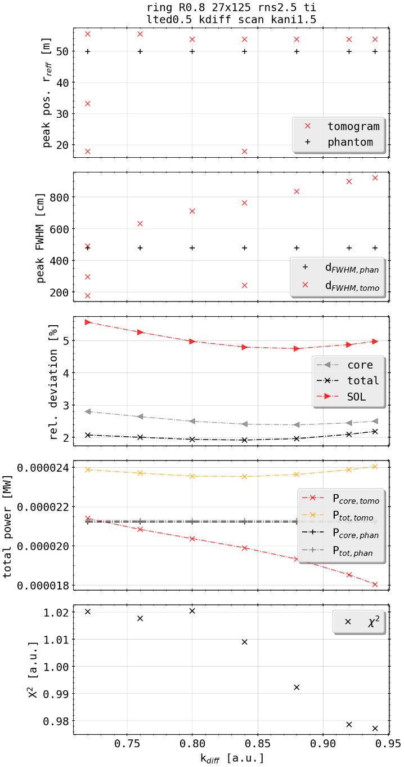
Phantom Test: Ring with 2.5% Random Error and Tilted Camera
use geometry previously set up when investigating the effects of errors to emissivities
add similar 2.5% noise to chordal profile, simulating actually measured experimental profile
change of best fit parameters according to 2D deviation and X² measurement
standard error in peak localization radially changed and increased
[cm]
[mm]
w/o error
with error

Slide 14
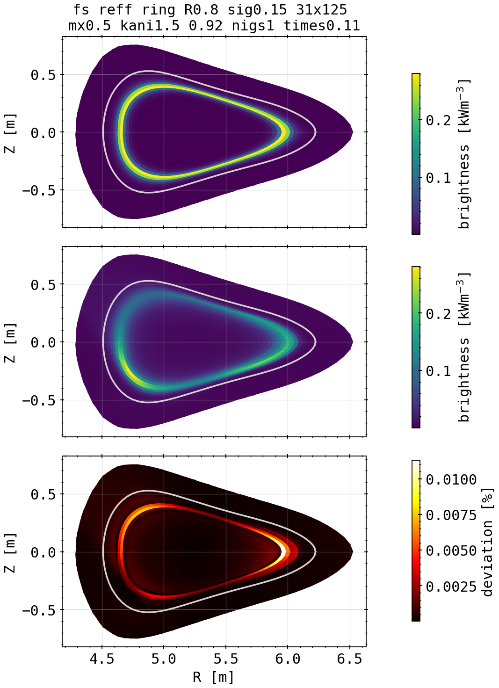
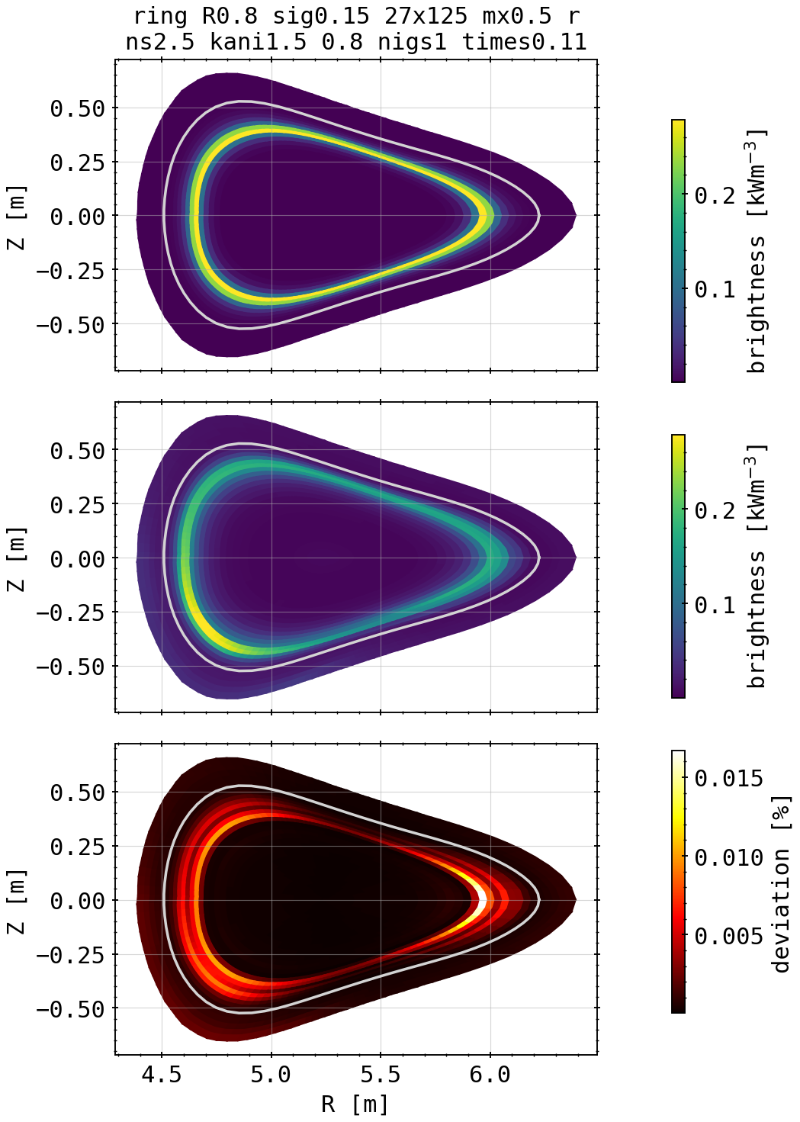
Phantom Test: Ring with 2.5% Random Error and Tilted Camera
[cm]
(phantom)
[mm]
(w/o error)
w/o error
with error
(with error)
radially shifted outside systematically
18.08.2020

Slide 15
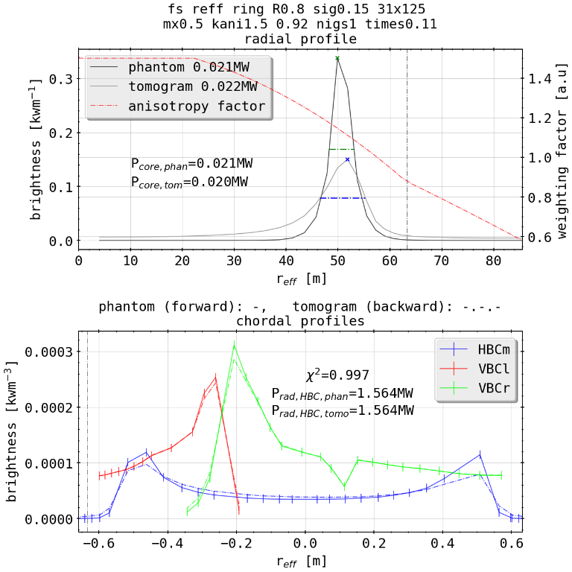
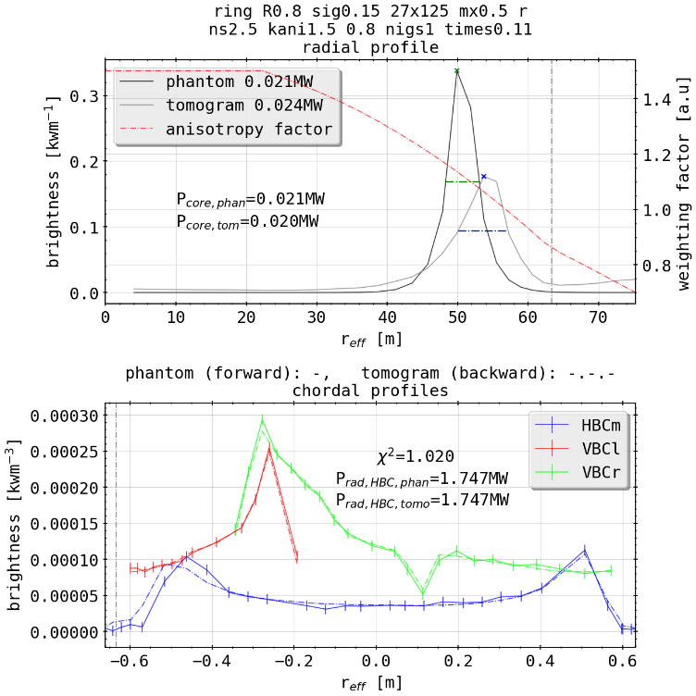
Phantom Test: Ring with 2.5% Random Error and Tilted Camera
[cm]
(w/o error)
[mm]
outward shift
w/o error
with error
Chordal peak orientation changed
(with error)
18.08.2020

Slide 16
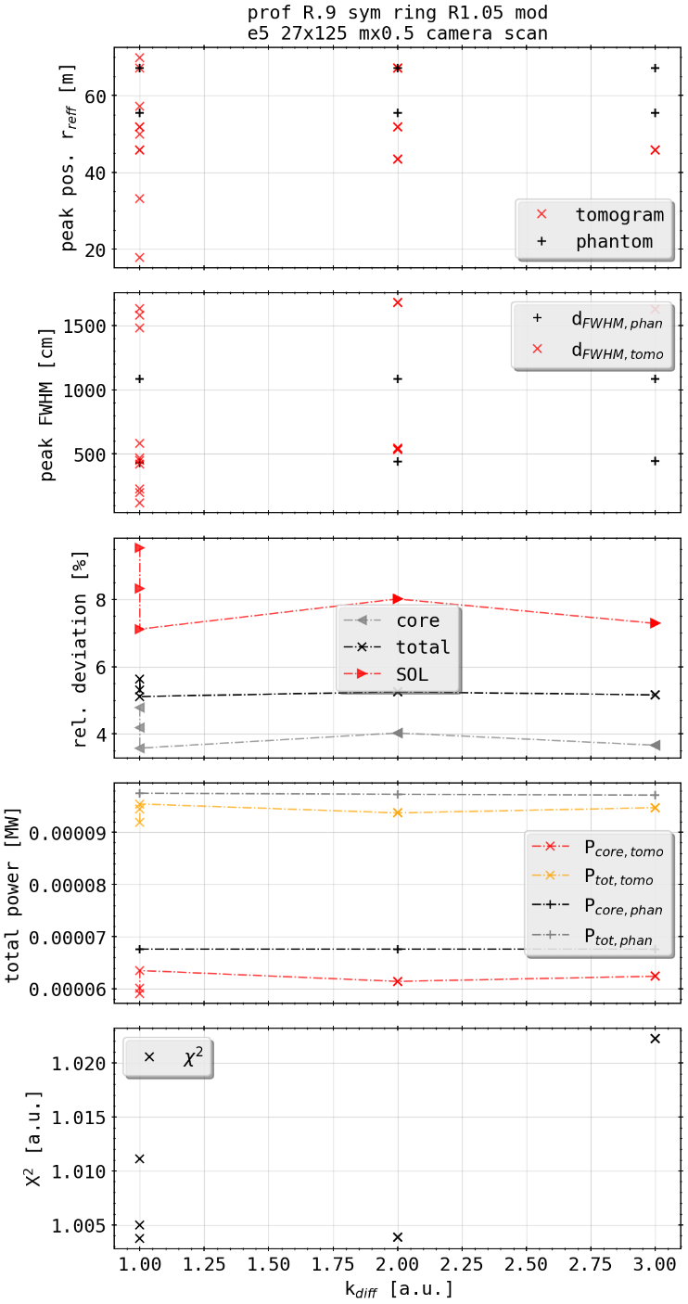
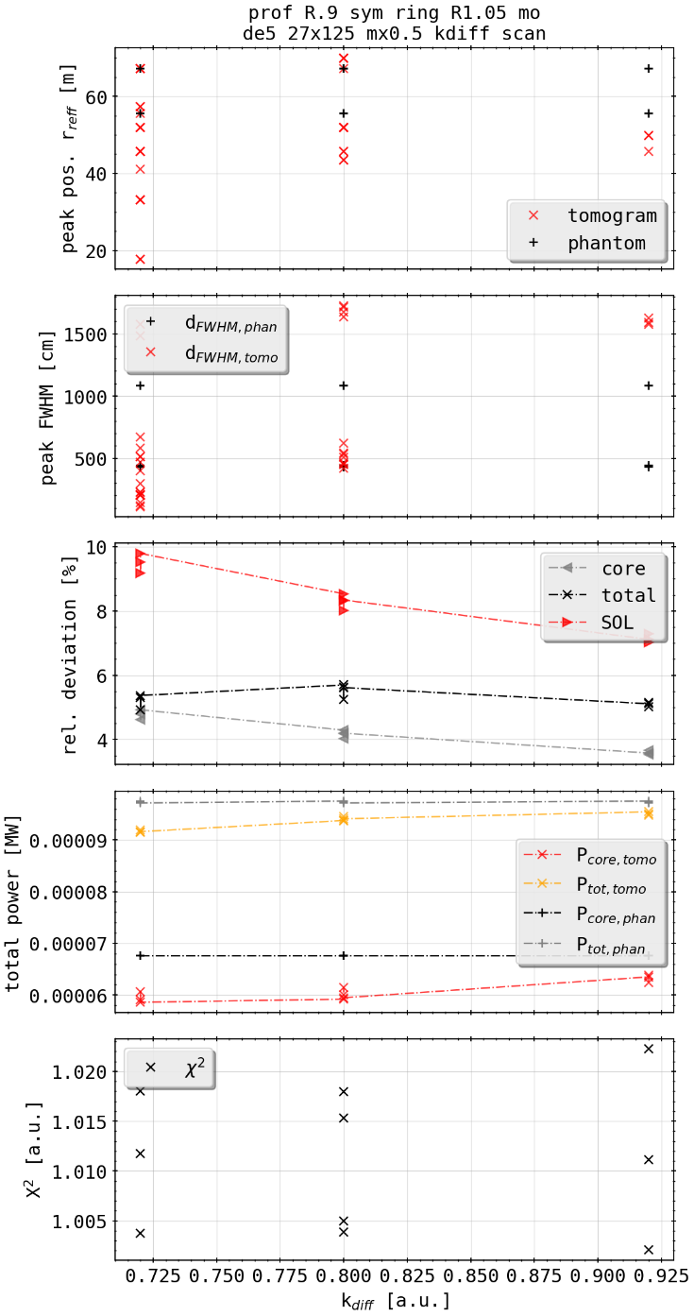
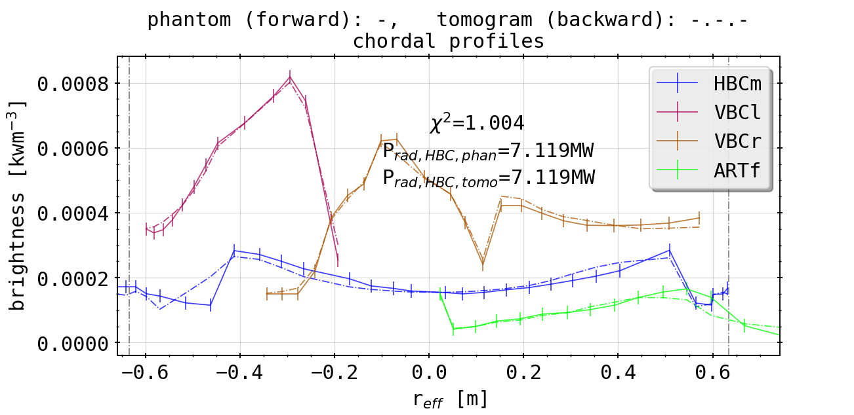
Phantom Test: Island Mimic and Radial Profile
radial profile inside shadowing over island structure
virtually not reproducible if poloidaly symmetric emissivity profile is superimposed
outside emissivity focused in front of HBC
X² fits overall better
camera scan
K factor scan
ARTh (2)

